Slide 1

TELECOM CUSTOMER CHURN PREDICTION
- ANKIT KATHOKE

Slide 2


Slide 3
CONTENT :
1.INTRODUCTION
WHAT IS CUSTOMER CHURN ?
HOW CAN CUSTOMER CHURN BE REDUCED ?
OBJECTIVES
2. LOADING LIBRARIES AND DATA
3. UNDERSTANDING THE DATA
4. FIND MISSING VLAUES
5. DATA MANIPULATION
6. DATA VISUALIZATION
7. DATA PREPROCESSING
8.Machine learning model evaluation and
prediction.
SVC
DECISSION TREE
RANDOM FOREST
LOGISTIC REGRESSION

Slide 4
INTRODUCTION
What is Customer Churn?
Customer churn is defined as when customers or subscribers discontinue doing business with a firm or service.
Customers in the telecom industry can choose from a variety of service providers and actively switch from one to the next. The telecommunications business has an annual churn rate of 15-25 percent in this highly competitive market.
Individualized customer retention is tough because most firms have a large number of customers and can't afford to devote much time to each of them. The costs would be too great, outweighing the additional revenue. However, if a corporation could forecast which customers are likely to leave ahead of time.
To reduce customer churn, telecom companies need to predict which customers are at high risk of churn.
To detect early signs of potential churn, one must first develop a holistic view of the customers and their interactions across numerous channels, including store/branch visits, product purchase histories, customer service calls, Web-based transactions, and social media interactions, to mention a few.

Slide 5
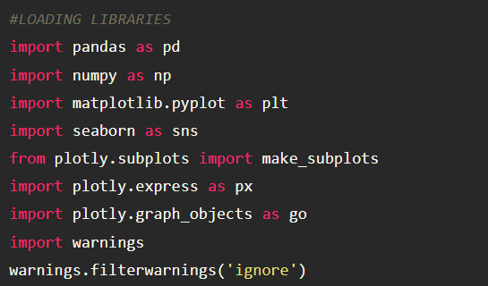
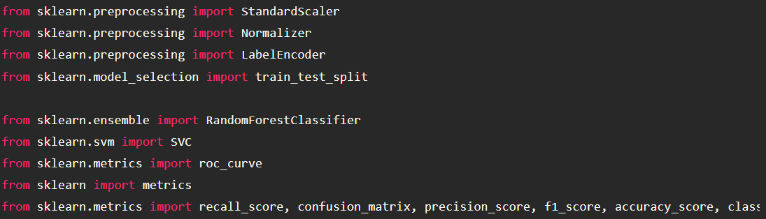
LOADING LIBRARIES AND DATA

Slide 6
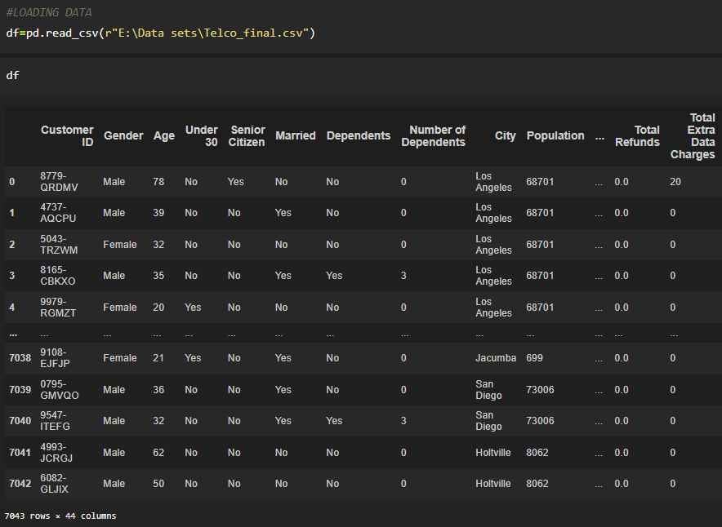
LOADING DATA

Slide 7
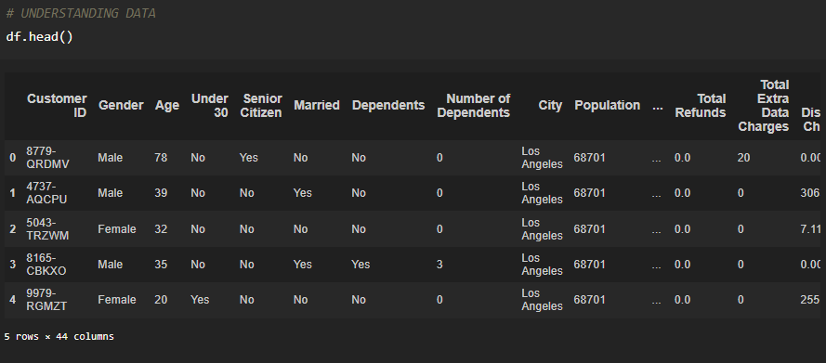
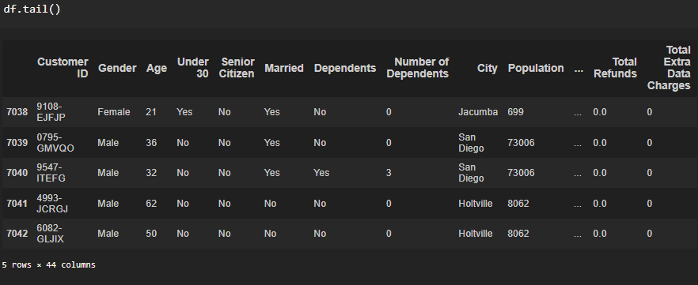
UNDERSTANDING THE DATA

Slide 8
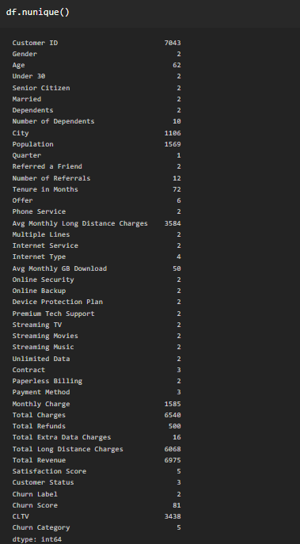
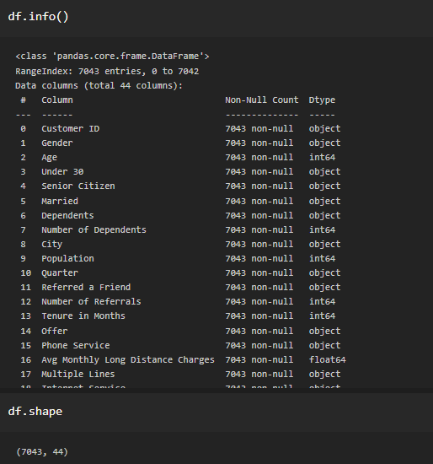

Slide 9
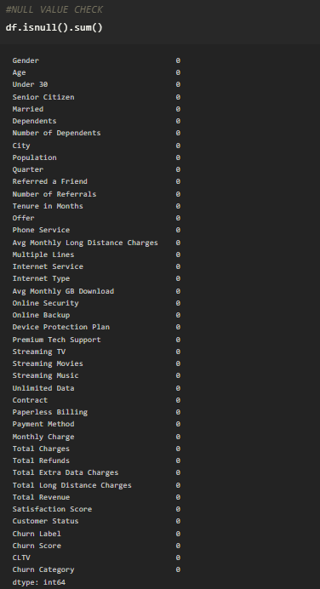
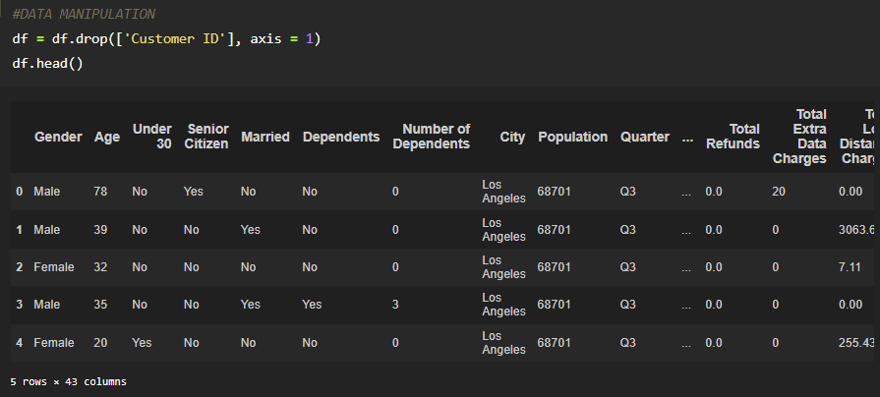
DATA MANIPULATION
Here we have checked null values and dropped the irrelevant attribute from the data.

Slide 10
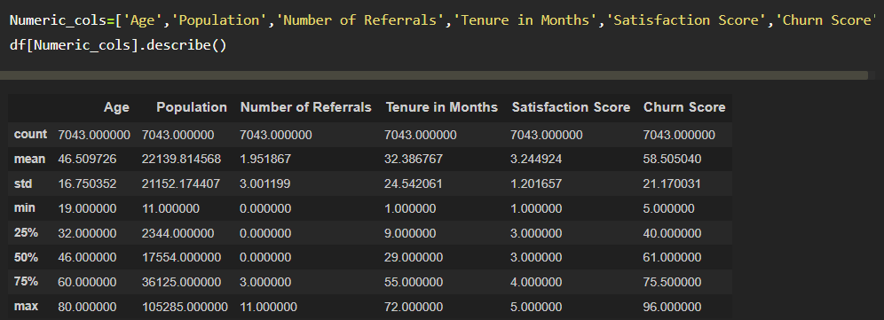
DESCRIPTIVE STATISTIC

Slide 11
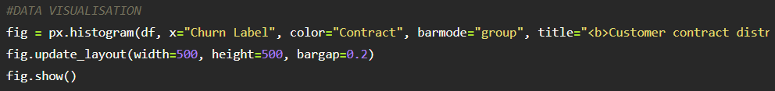
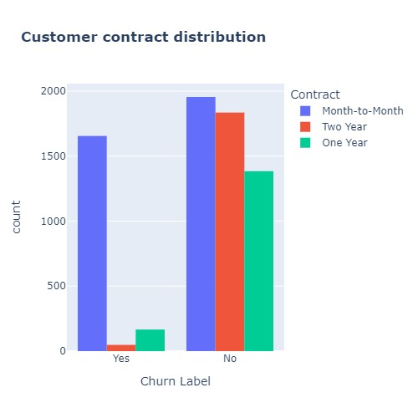
DATA VISUALIZATION
INSIGHT WE FOUND THAT
CUSTOMER CHURN COUNT W.R.T CONTRACT DISTRIBUTION
CONTRACT | YES | NO
MONTH TO MONTH | 1655 | 1955
TWO YEAR | 48 | 1835
ONE YEAR | 166 | 1384

Slide 12
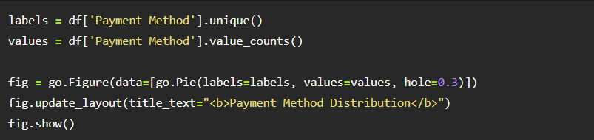
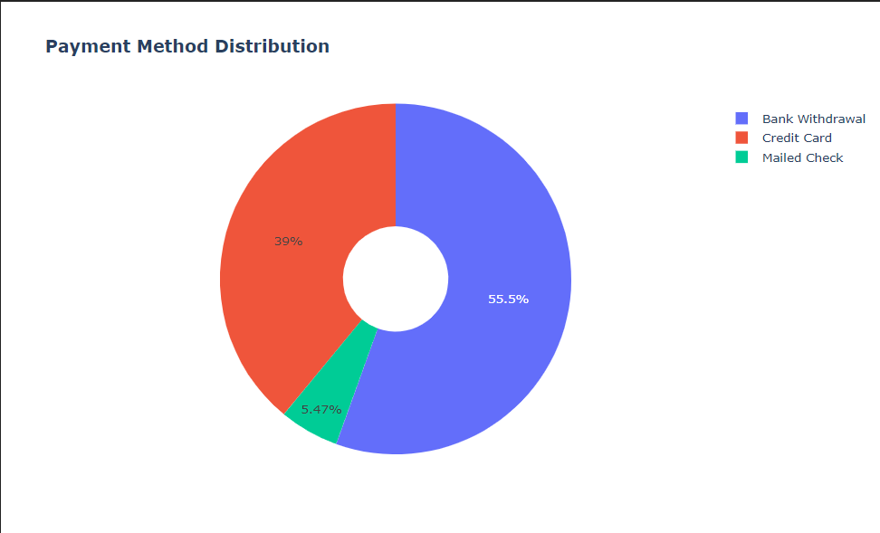
HERE WE CHECK THE PAYMENT METHOD OF EACH AND EVERY CUSTOMER.
 | PERCENTAGE | COUNTS
BANK WITHDRAWL | 55.5% | 3909
CREDIT CARD | 39% | 2749
MAILED CHECK | 5.47% | 385

Slide 13
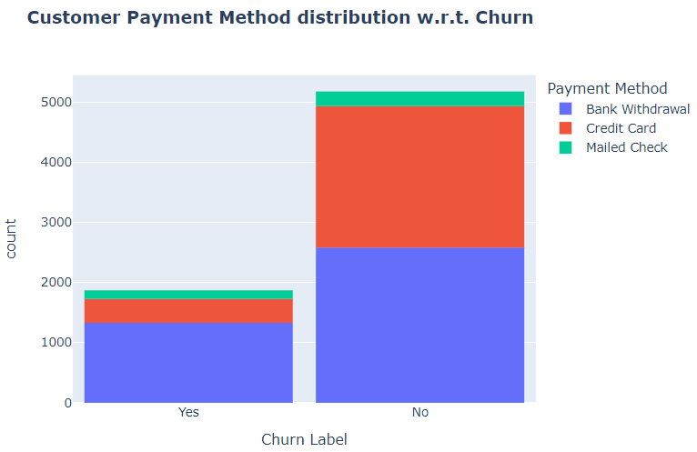
HERE WE HAVE CHECK CHURN CATEGORY W.R.T PAYMENT METHOD
 | YES | NO
BANK WITHDRAWAL | 1329 | 2580
CREDIT CARD | 398 | 2351
MAILED CHECK | 142 | 243

Slide 14
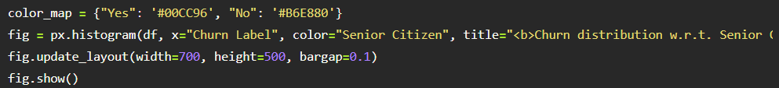
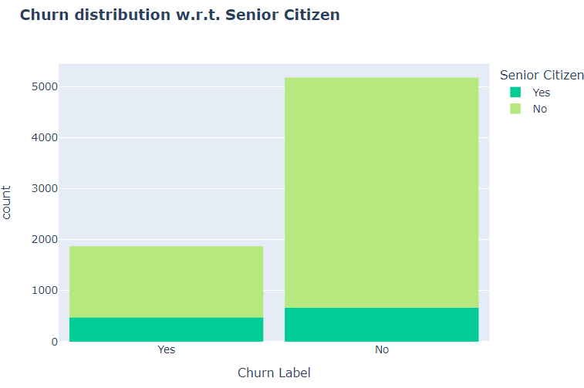
HERE WE CHECK CHURN CATEGORY W.R.T. CITIZEN
 | CHURN YES | CHURN NO
S.CITIZEN YES | 476 | 666
S.CITIZEN NO | 1393 | 4508

Slide 15
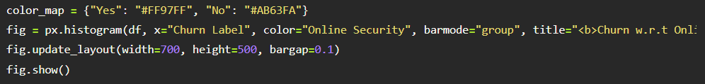
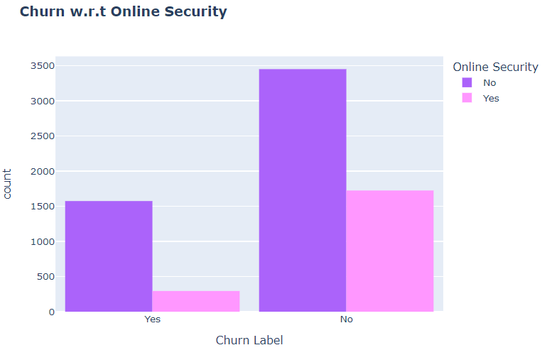
HERE WE HAVE CHECK CHURN CATEGORY W.R.T ONLINE SECURITY
 | CHURN YES | CHURN NO
O.SECURITY YES | 295 | 1724
O.SECURITY NO | 1574 | 3450

Slide 16
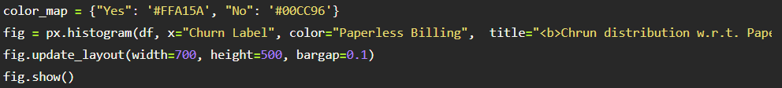
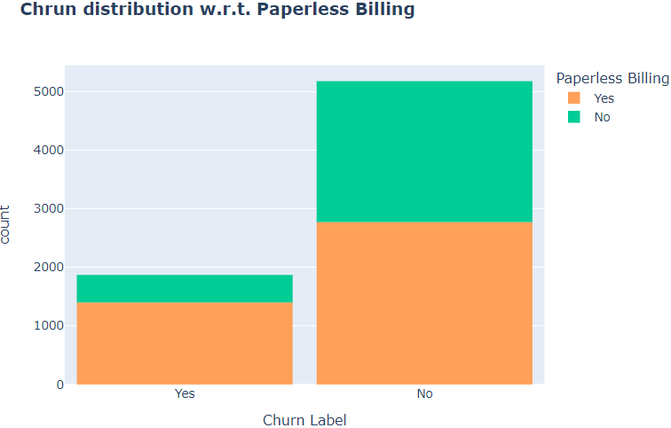
HERE WE HAVE CHECK CHURN CATEGORY W.R.T PAPERLESS BILLING
 | CHURN YES | CHURN NO
PAPERLESS BILLING YES | 1400 | 2771
PAPERLESS BILLING NO | 469 | 2403

Slide 17
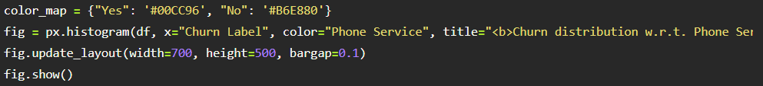
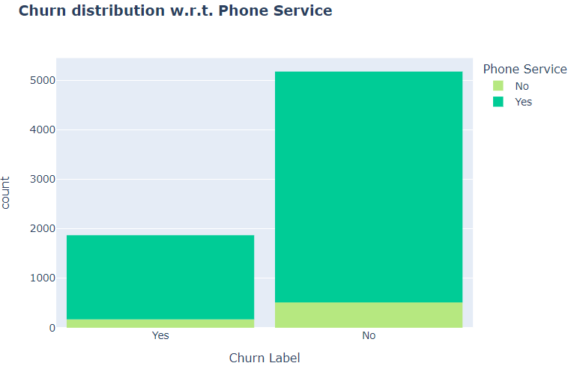
HERE WE HAVE CHECK CHURN CATEGORY W.R.T PHONE SERVICE
 | CHURN YES | CHURN NO
P. SERVICE YES | 1699 | 4662
P. SERVICE NO | 170 | 512

Slide 18
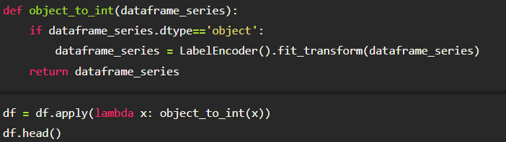
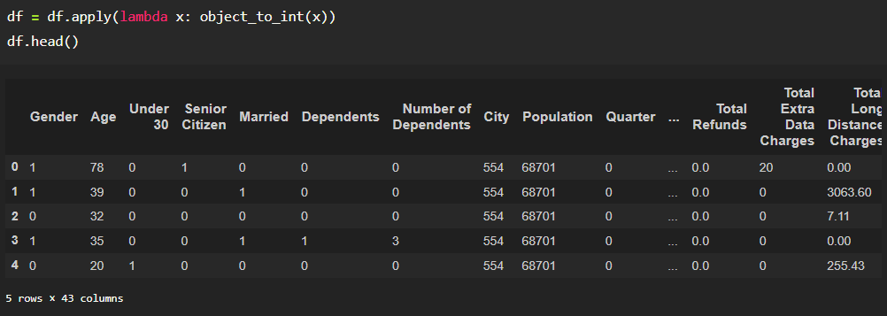
DATA TRANSFORMATION

Slide 19
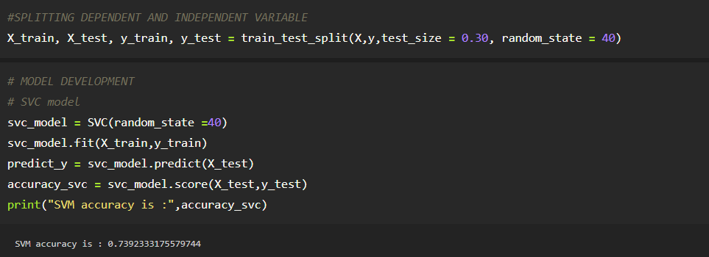
SPLITTING DATA INTO DEPENDENT AND INDEPENDENT VARIABLE AND MODEL DEVELOPMENT
HERE WE SPLIT THE DATA INTO DEPENDENT AND INDEPENDENT VARIABLE AND DEVELOPED THE SUPPORT VECTOR CLASSIFIER MODEL WE GOT 73.92% OF ACCURACY ON TRAINED DATA

Slide 20
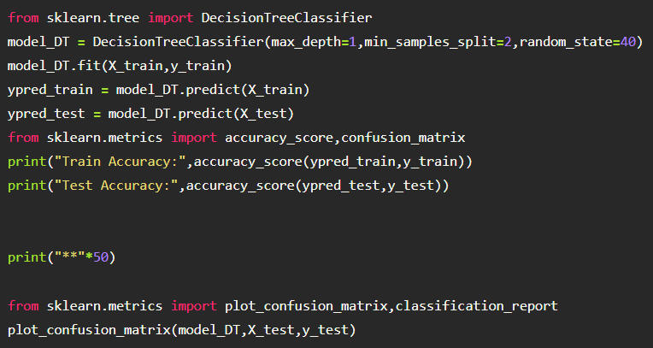
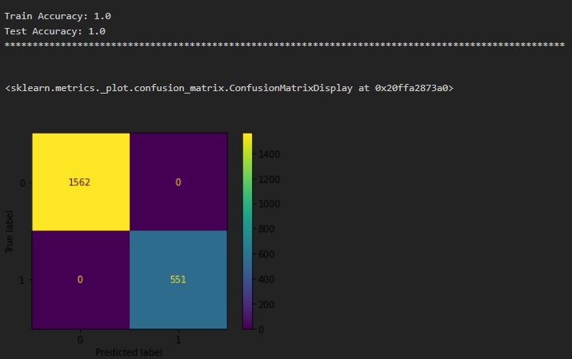
DECISSION TREE CLASSIFIER
HERE WE DEVELOPED DECISSION TREE CLASSIFIER MODEL WE FOUND IT IS OVERFITTING

Slide 21
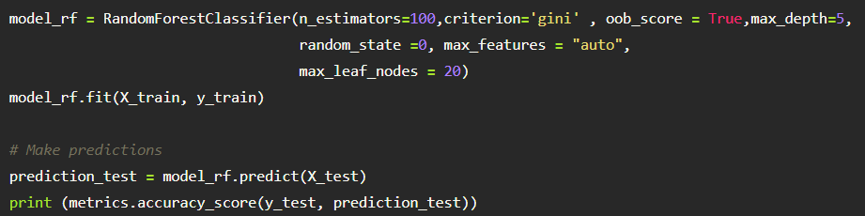
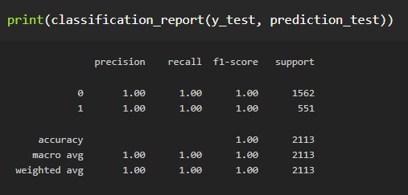
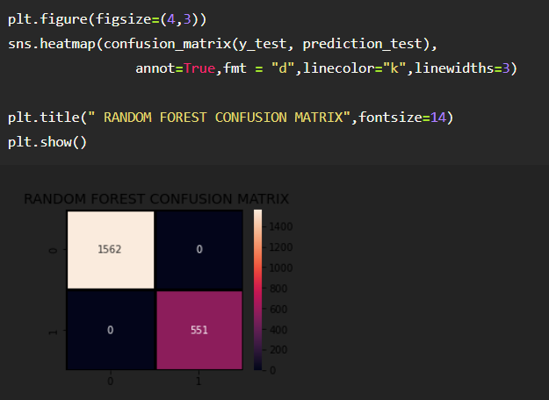
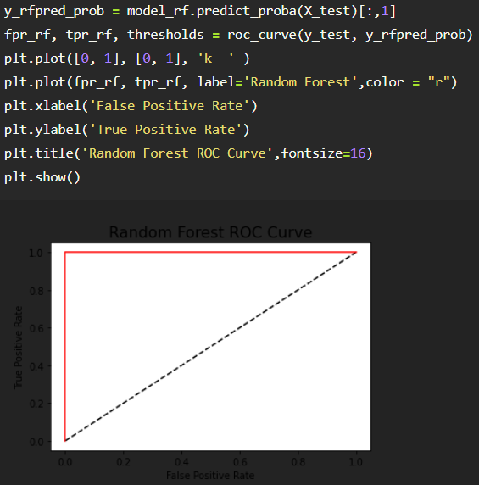
RANDOM FOREST CLASSIFIER
HERE WE DEVELOP RANDOM FOREST CLASSIFIER IT IS ALSO OVERFITTING

Slide 22
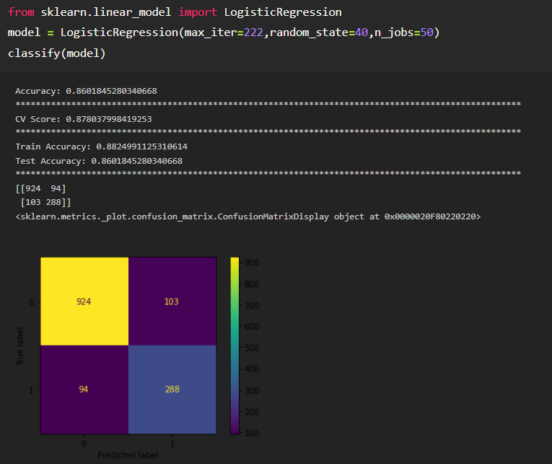
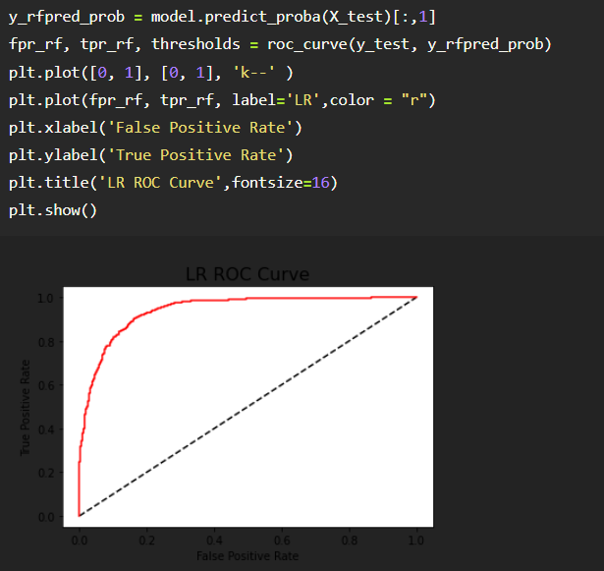
LOGISTIC REGRESSION
FINALLY WE GOT BETTER ACCURACY OF LOGISTIC REGRESSION WITH 88.24% ON TRAINED DATA.

Slide 23


